Slide 1
TEAM TECHNO HACKERS Anurag
TEAM
TECHNO HACKERS
TEAM MEMBERS:
ANURAG
MANOGNA
VISHISHTA
BALAKRISHNA

Slide 2
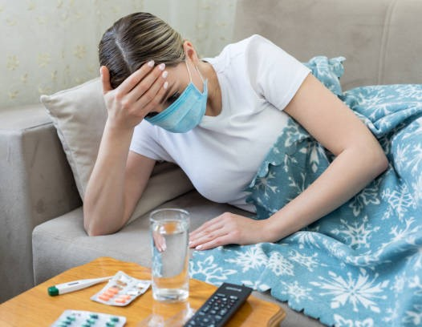
.
PROBLEM STATEMENT
Many people are not aware of various medication methods to be used for a certain problem.
They visit doctors for very simple reasons due to the fear of future problem
Health Care being commercial

Slide 3
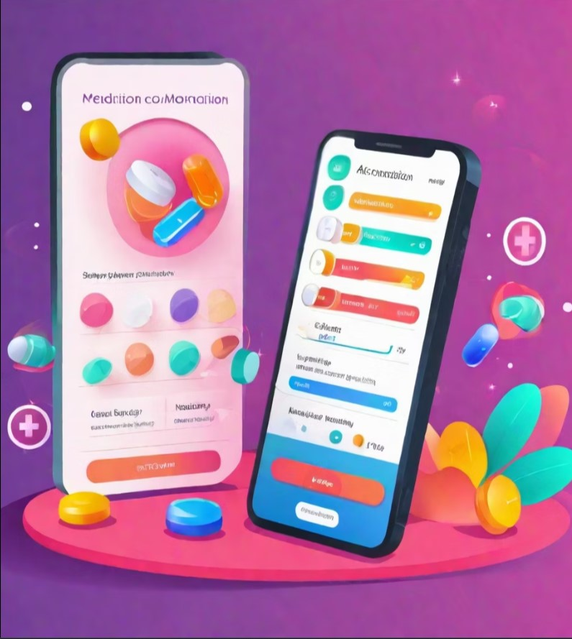
.
PROPOSED SOLUTION
An application for medicine recommendation in different treatment domains through questionarie
Like,
Allopathy
Homeopathy
Ayurvedic
Also through this app the user can get details about the medical stores, side affects, tests to be taken

Slide 4
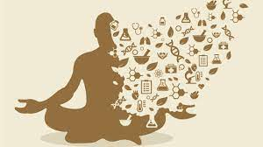
MEDICAYUR

Slide 5

FLOW CHART
PATIENT
AYURVEDIC
ALLOPATHY
MEDICINE RECOMENDATION
SYMPTOMS
(QUESTIONARIE)
HOMEOPATHY
TESTS SUGGESTION
FOOD SUGGESTION
AVAILABLE STORES

Slide 6





TECHNOLOGY STACK

Slide 7
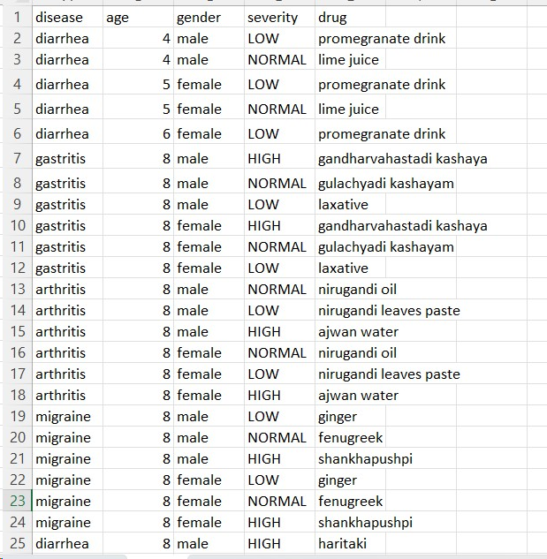
DATASET OF AYURVEDIC MEDICINES

Slide 8
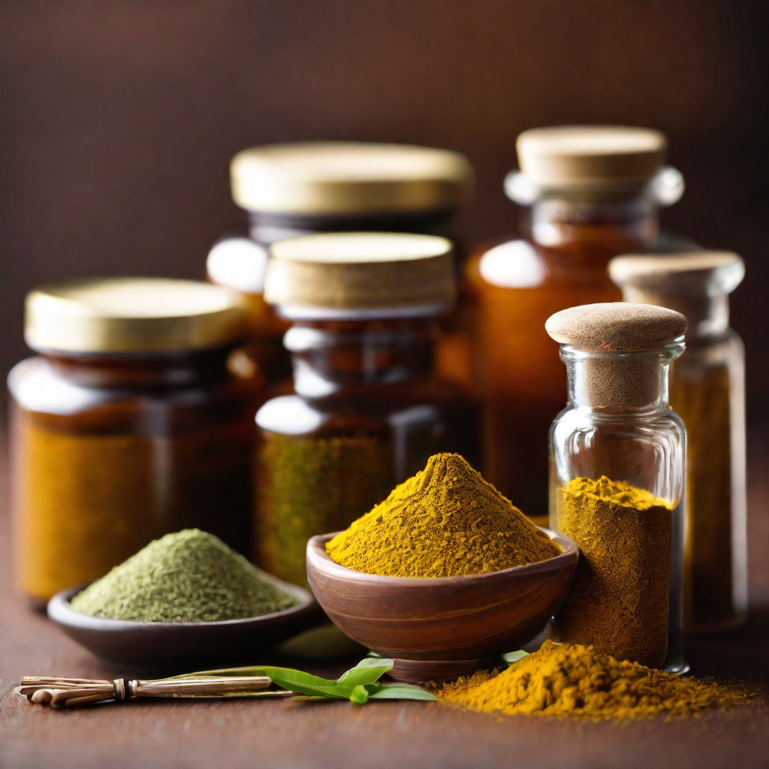
AYURVEDIC
Ayurvedic medicine takes a holistic approach to health, considering the mind, body, and spirit.
Ayurvedic medicine often uses herbal supplements to support health and wellness.
Our app uses your answers to the questionnaire to generate personalised ayurvedic medication recommendation
.

Slide 9
BENEFITS
Our medication recommendation app offers several benefits to users, including
Personalized recommendations based on user interests and questionnaire responses
Access to a wide range of medication options across different medicinal practices
Easy and convenient medication selection process
Improved medication adherence and overall health outcomes

Slide 10
BUSINESS MODEL
PROMOTES MEDICAL STORES
MEDICAL BRANDS
PROMOTION
COLLABRATION &
COMISSION WORKS
SUGGEST
DOCTORS

Slide 11
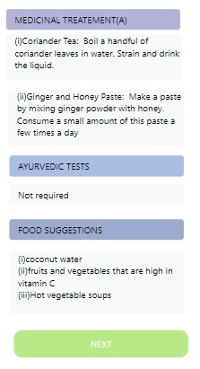

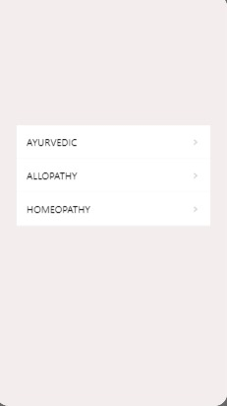
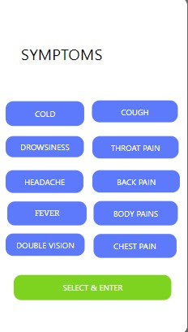
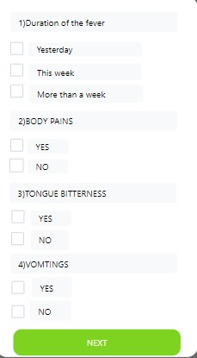
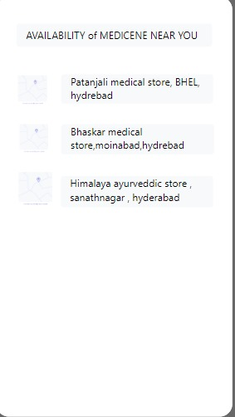
OUTPUT
MEDICAYUR

Slide 12
THANK YOU

